Slide 1
How to use Approval Tests for C++ Effectively
Clare Macrae (She/her) clare@claremacrae.co.uk 23 June 2020 CppEurope

Slide 2


About Me
C++ and Qt developer since 1999
My mission: Sustainable and efficient testing and refactoring of legacy code
Co-author of “Approval Tests for C++”
Consulting & training
https://claremacrae.co.uk
All links from this talk via:
github.com/claremacrae/talks

Slide 3
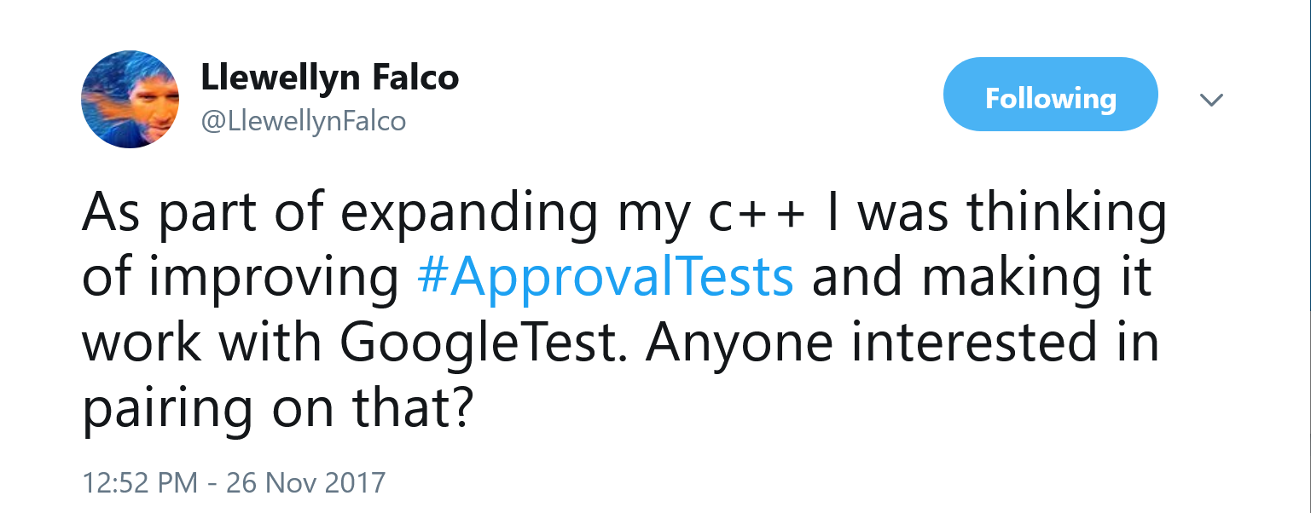

Slide 4


Slide 5
“Approval Tests allow you to verify a chunk of output (such as a file) in one operation as opposed to writing test assertions for each element”

Slide 6
Demo 1: Hello Approvals

Slide 7
Main Methods
Approvals::verify(std::string, Options)
2 other overloads take template types
Approvals::verifyAll()
For use with containers
Writes one element at a time
All are in namespace ApprovalTests

Slide 8
Stages of Approvals::verify()
verify()
writes "received"
Same?
Pass
Fail
Reporter
object
reads "approved"

Slide 9
Easy to:
… Add tests quickly
… Visualise differences
… Update output
Convenience
Separates test data from test code
Ignore end-of-line differences

Slide 10
Easy setup
Single header
https://github.com/approvals/ApprovalTests.cpp/releases
Finds diff tool automatically
Sensible filenames automatically
source_directory/test_filename.test_name.approved.txt
“It just works”

Slide 11
Separation
Separates test data from test code

Slide 12




Supported Test Frameworks
Lots to choose from:
Get to know chosen one well!

Slide 13
Demo 2: Legacy Code: Gilded Rose

Slide 14
Approvals and Legacy Code
Before you start refactoring…
Achieve good coverage
verifyAllCombinations()
Not just for legacy code

Slide 15
Lots of String Conversion Options
String Conversions
Pass in a std::string
Use Approvals::verify( object, lambda )
Write custom operator<<( std::ostream, … )
Specialize ApprovalTests::StringMaker::toString( … )
Use TApprovals<YourStringConvertingClass>
How to Use the Fmt Library To Print Objects
Use {fmt} library via FmtApprovals::verify()

Slide 16
String Design Guidelines
Objects print their relevant data
The data is consistent between runs
(no times, pointers, random)
The data is easy to read, at a glance:
Advice: Tips for Designing Strings
[0] = [x: 4 y: 50 width: 100 height: 61] [1] = [x: 50 y: 5200 width: 400 height: 62] [2] = [x: 60 y: 3 width: 7 height: 63] | (x,y,width,height) = (4,50,100,61) (x,y,width,height) = (50,5200,400,62) (x,y,width,height) = (60,3,7,63)

Slide 17
Demo 3: Log Files

Slide 18
Key Points
Approvals::verifyExistingFile()
For when the file is already written
Scrubbers for non-deterministic output
More scrubber options coming soon…

Slide 19
Customisation Points Overview

Slide 20
Stages of Approvals::verify()
Namer
Writer
Comparator
Pass
Fail
Reporter
Scrubber

Slide 21
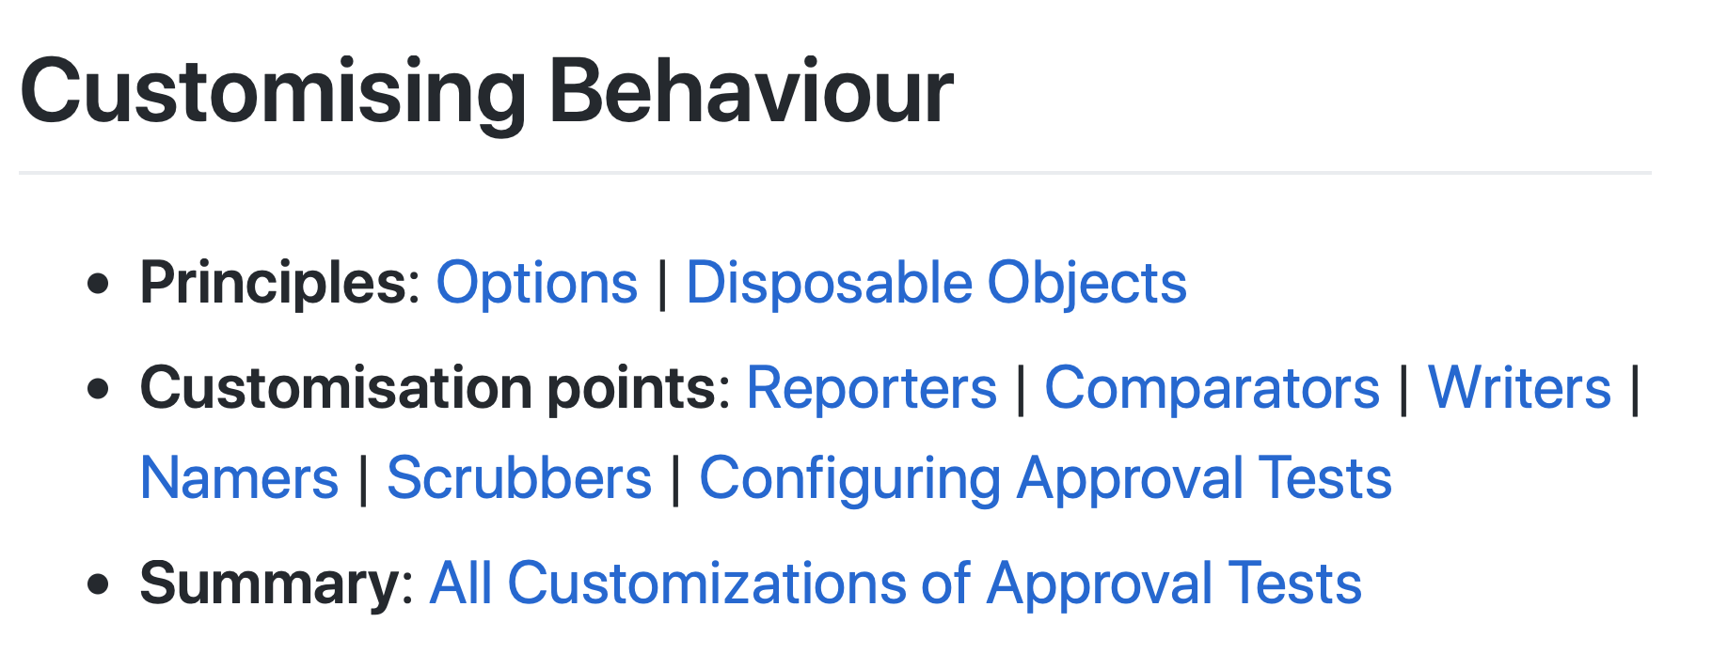
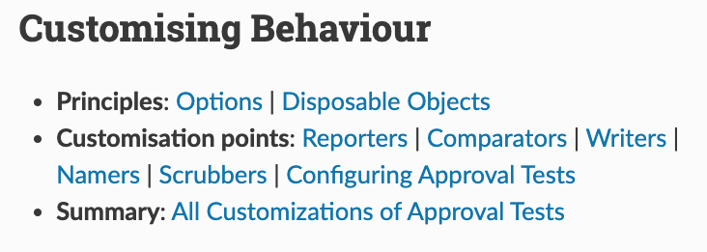
Everything is customisable
We take great pride in the docs
All examples generated from compiled, tested code
github.com/approvals/ApprovalTests.cpp/blob/master/doc/
approvaltestscpp.readthedocs.io/en/latest/

Slide 22
Demo 4: SVG Files

Slide 23
Key Points
Custom Reporters can help understand failures
Make it easy to visualise differences
No need to version control .png files

Slide 24
Common Challenges

Slide 25
External Resources
I/O, Networking, System API calls…
Be creative!
Can you intercept and log calls?
And save them as “approved” results?
Then intercept again during later runs, and compare results?
You can even use this data as inputs to later tests!
Excellent example from Angie Jones:
https://angiejones.tech/verifying-entire-api-responses/

Slide 26
Embedded Systems
Separate as much logic as possible
Test the logic on desktop machines and CI
Then if you get a failure on device, you’ve got less to test
It may become possible to run Approval Tests from cross-built code

Slide 27
Output is OS-specific
Include the OS in the file-names
So verify() compares against output from same platform
For example
TestQtDialog.loginScreen.onMacOSX.approved.png
TestQtDialog.loginScreen.onWindows.approved.png
TestQtDialog.loginScreen.onLinux.approved.png
See Multiple output files per test

Slide 28
Approving is fiddly or takes too long
Approving images?
Approving hundreds of files?
Try one of:
AutoApproveIfMissingReporter
AutoApproveReporter (and compare the diffs in version control!)

Slide 29
“Approval Tests allow you to verify a chunk of output (such as a file) in one operation as opposed to writing test assertions for each element”

Slide 30
How to use Approval Tests for C++ Effectively
All links from this talk, and more, via:
github.com/claremacrae/talks
Sustainable and efficient testing and refactoring of legacy code
Consulting & Training
https://claremacrae.co.uk
clare@claremacrae.co.uk
Any Questions?
Notes:
A lot of this stuff you can get going on your own. If you get stuck, I can help you!

